Slide 1
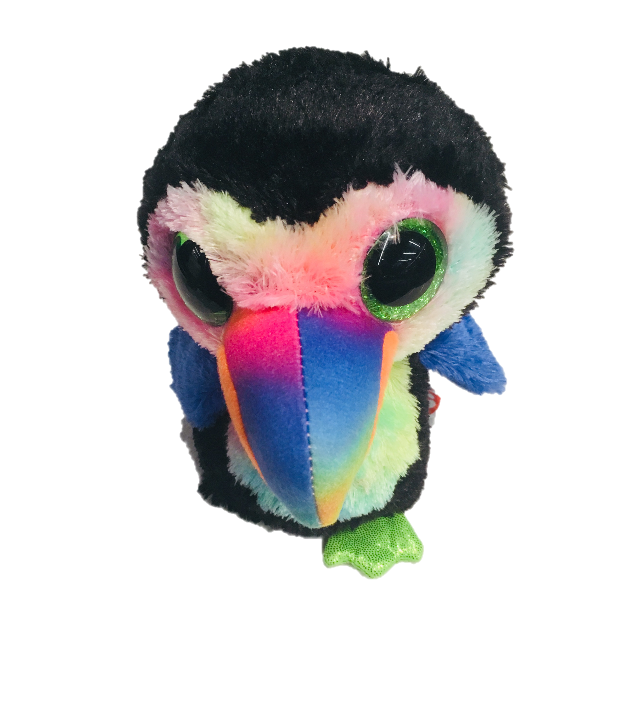
oTree workshop
Philipp Chapkovski
European University Institute
University of St.Gallen
May 22-25, 2018
Day 4

Slide 2
oTree
link to follow:
otree-workshop.herokuapp.com/room/stgallen/

Slide 3
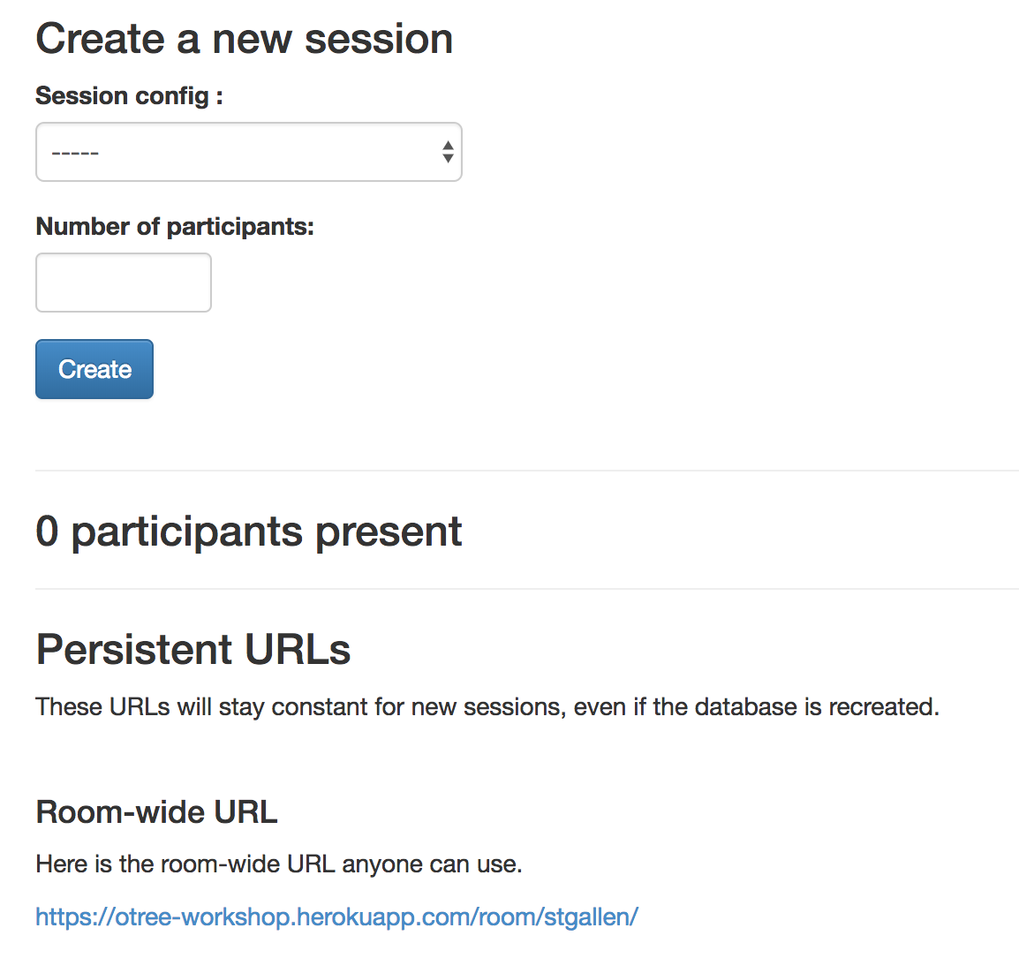
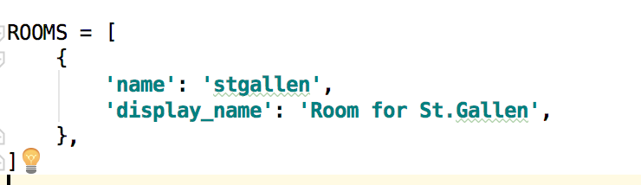
Rooms:

Slide 4
Obtaining data from other players
self.group.get_players()
self.player.get_others_in_group()
TotalContribution = sum([p.contribution for p in self.get_players])

Slide 5

This is session.
The entire set of all participants in your lab
or online

Slide 6
This is participant.
The entire set of all participants in your lab
or online

Slide 7
Subsession
is a set of all players in one round

Slide 8
Player is an element of
subsession

Slide 9
One participant
contains the info
about all players
who he/she
‘owns’

Slide 10
The group
is a set of players
in one particular
subsession

Slide 11
Obtaining data from previous rounds
participant.get_players()
participant.payoff
player.in_all_rounds()
player.in_previous_rounds()
player.in_round(x)
player.in_rounds(x,y)
on template:
{{player.round_number}}
on page:
self.round_number

Slide 12
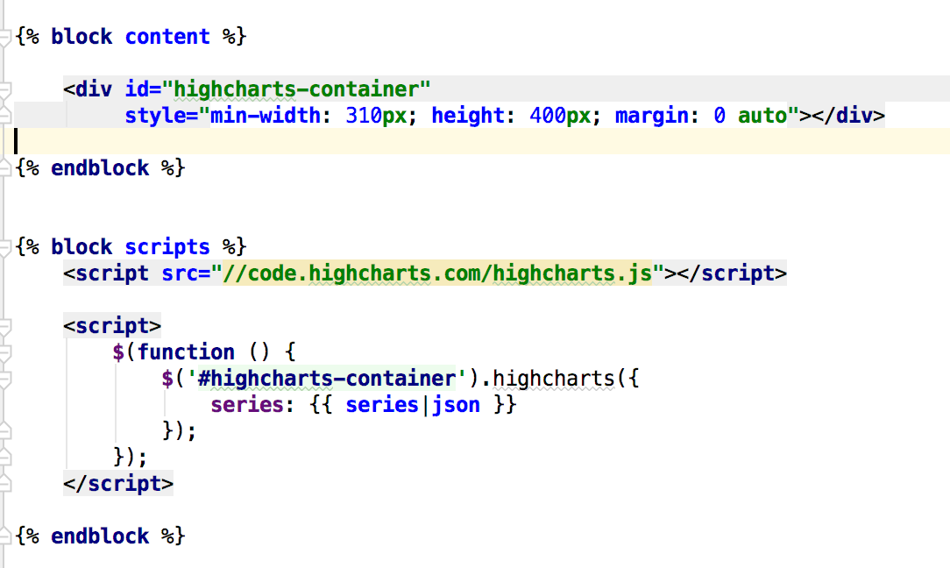
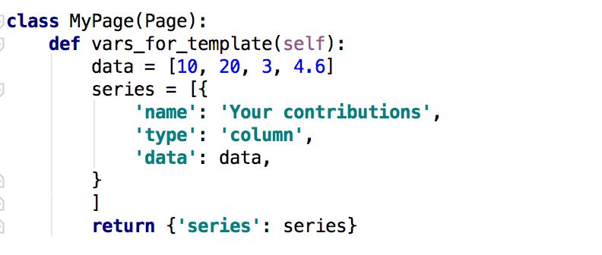
Charts

